Slide 1
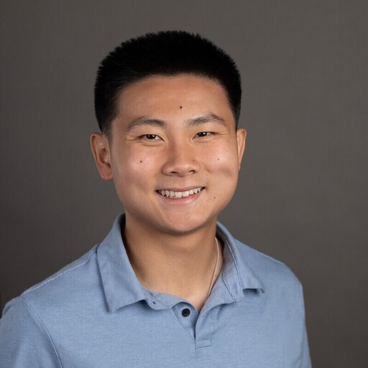
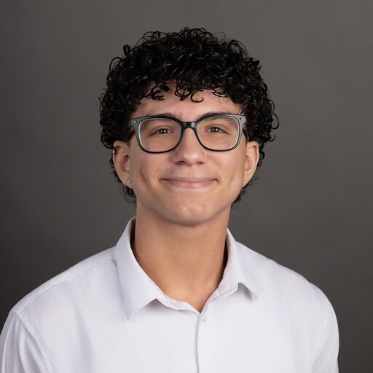
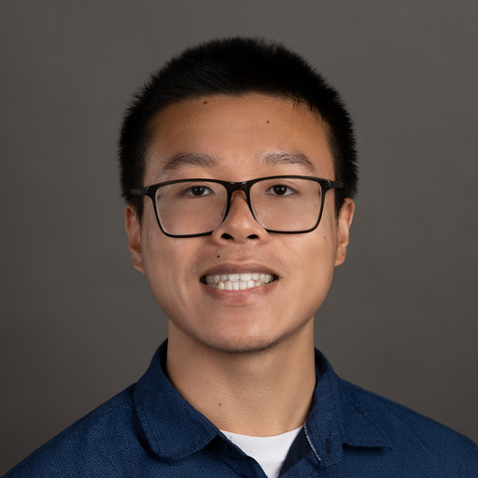
Calculus-Readiness City-Builder
A remedial math app that sustains engagement from start to finish
Gabriel Xiong
Evan Cabrera
Anthony Zheng
2029 · UT Austin
2029 · MIT
2028 · MIT

Slide 2
The Retention Problem
56%
of developmental-math students never completed the sequence
Source: PPIC, 2016 — California Community Colleges, 200K+ developmental-math students
Notes:
Same data, loss framing: 56 of every 100 students never finish the sequence.

Slide 3
Our Solution
01
Diagnose
Find each student's missing prerequisites.
02
Teach
Cover those gaps and nothing else.
03
Sustain engagement
Give students a reason to keep coming back.
Notes:
And that's where our product wins: engagement. Instead of a lengthy course that loses students, we diagnose exactly what they're missing, teach only those gaps, and keep students engaged with a light gamification layer.

Slide 4
Live Demo
Diagnose → Learn → Practice → Advance

